Slide 1
Data Compression
Joe Bustamante & Andrew Rot

Slide 2
An Introduction to Data Compression
- Data Compression is the process of encoding information in a way that takes up less space than the original, raw data, usually with the goal that all or most of that information can be unencoded.
Can be done on files of any type. Anything you download from the internet is compressed (decompression is most of what happens when something is “installing”)

Slide 3
An Introduction to Data Compression
Many different data compression algorithms have been developed over the years, many of them specific to text, images, music, and more.
We’ve talked about Huffman Encoding, one of the more famous algorithms
It’s an example of lossless compression, but there is also lossy compression

Slide 4
Lossy vs. Lossless
Lossless compression: when data is decompressed, it is restored in the exact same state or without loss of information
Huffman Encoding
LZ77
PNG, BMP, WAV
Lossy Compression: upon decompression, some elements are lost or unable to be restored, some loss of fidelity.
MP3
JPG/JPEG

Slide 5
Huffman Encoding
A quick review of Huffman Encoding:
Variable-length prefix encoding - the more frequent characters take up less space
Build a tree with the most frequent characters at the top with each child receiving an additional 1 or 0 in their encoding

Slide 6
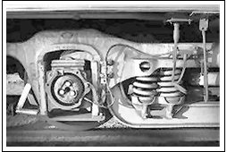
JPEG
The JPEG algorithm is a lossy compression algorithm designed for images.
It uses a number of mathematical principles to shrink file sizes while trying to maintain the overall visual integrity of an image.
We’ll use this image as a quick example to demonstrate the JPEG algorithm.

Slide 7
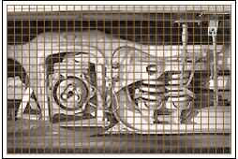
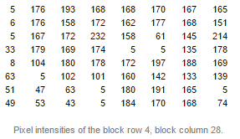
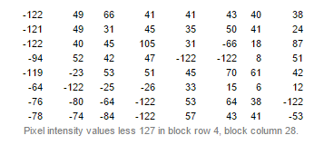
JPEG - Preprocessing
Section the image into 8x8 pixels
Take the pixel matrix of each 8x8 section (shown below)
Subtract constant to get closer to zero usually 128 (midpoint) for an 8 bit range
Doing this allows you to minimize the amount of data that needs to be stored while (thus darkening the image) but keeps most of the data integrity.

Slide 8
JPEG - Transformation
Transforms the RGB values of each pixel to another color space which represents the brightness, the red value, and the blue value
This allows large amounts of compression without affecting the visual quality of the picture too much.
This is how TVs and DVDs encode the color of their pictures

Slide 9
JPEG - Quantization
The human eye is not good at distinguishing the exact strength of high frequency brightness in an image
Because of this we can remove a lot of the information that is stored in areas that have high brightness. This is usually done through dividing each part of the brightness in the area by some constant factor and then rounding to the nearest integer
Many of the higher brightness components are, in fact, rounded to either zero or a small number, which can be encoded in many less bits
This is the only lossy operation in all of the JPEG algorithm. You can’t unround or retain the original values once the computation is done.

Slide 10
JPEG - Encoding
This encodes the image components by arranging them diagonally and then using something called Run Length Encoding (RLE)
RLE has to do with grouping similar frequencies together, adding zeroes to denote length coding, and then using huffman encoding to compress those zeroes a lot more. It also has to do with factoring coefficients
This technique adds about 70% compression to the image!

Slide 11
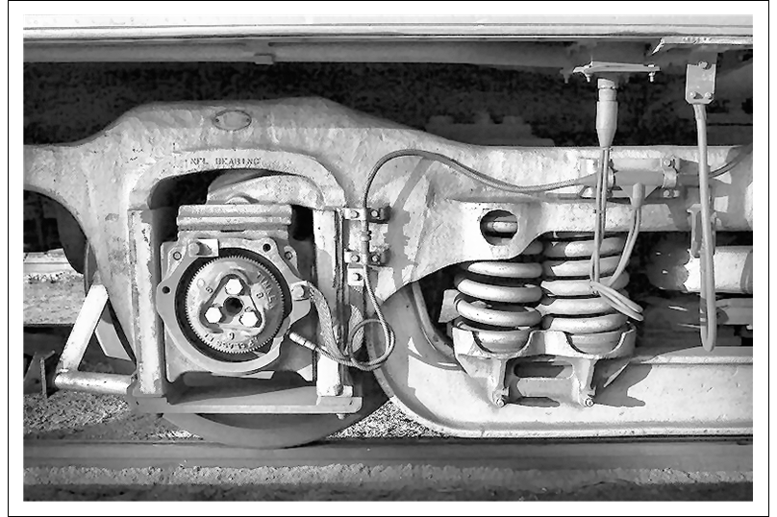
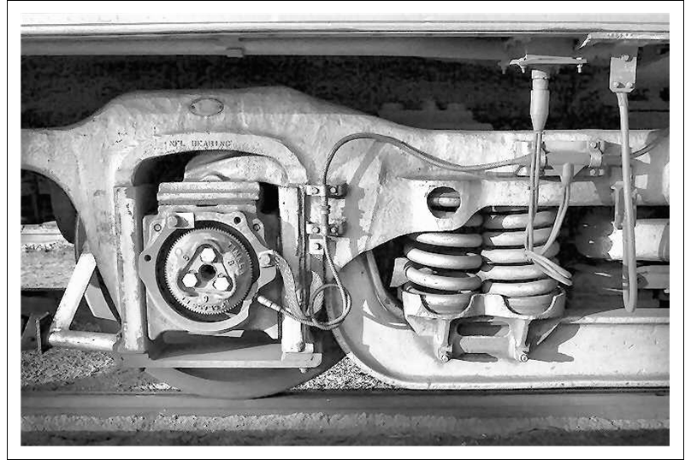
JPEG - A Final Comparison
The images are hardly differentiable, but the one on the right is over 75% smaller!

Slide 12
Lossless Compression & Huffman Encoding
Now, what if we had a way to not just encode single characters, but entire patterns and strings?
This could potentially result in much smaller or more compressed file sizes than what we were able to achieve before with simple Huffman Encoding.
This idea is the topic of the Lempel-Ziv Paper in 1977, which resulted in the LZ77 algorithm.

Slide 13
LZ77
First, let’s watch a short video to get a good idea on how the algorithm actually works:
https://www.youtube.com/watch?v=goOa3DGezUA&t=4s

Slide 14
LZ77
LZ77 is an adaptive-dictionary encoding method, which means it keeps track of a dictionary as it goes which adjusts depending on where or what characters are currently being looked at.
The advantage of this is that no dictionary needs to be included with the compressed file - the decompressor can figure it out as it goes.
LZ77 is one of the better compression algorithms, at the cost of speed.

Slide 15
LZ77
The algorithm works by maintaining a sliding window of a certain amount of characters. This sliding window is further broken up into a search buffer and a lookahead buffer.
The search buffer keeps track of previously encoded data. The lookahead buffer keeps track of the data that has yet to be encoded.
The algorithm works by taking the entire lookahead buffer and then finding the largest string match between that and the search buffer. (matches must be of at least length 2)

Slide 16
LZ77 - An Example
Input string: “ababcbababaaaaaa” - Search size: 4, Lookahead size: 4
DONE | SEARCH | LOOKAHEAD | STRING | OUTPUT
- | - | abab | cbababaaaaaa | ( 0 0 a)
- | a | babc | bababaaaaaa | (0 0 b)
- | ab | abcb | ababaaaaaa | (2 2 c)
a | babc | baba | baaaaaa | (0 3 a)
ababc | baba | baaa | aaa | (0 2 a)
ababcbab | abaa | aaaa | - | (2 3 a)
Final outputted string: (0 0 a) (0 0 b) (2 2 c) (0 3 a) (0 2 a) (2 3 a)
- Assume each reference is 2 bytes - 1 for location and one for next character. We went from 16 characters to 12!

Slide 17
LZ77 - Decompressing
(0 0 a) (0 0 b) (2 2 c) (0 3 a) (0 2 a) (2 3 a)
INPUT | OUTPUT | DONE | SEARCH | LOOKAHEAD | TOTAL SO FAR
(0 0 a) | a | - | - | a | a
(0 0 b) | b | - | - - - a | b | ab
(2 2 c) | abc | - | - - a b | abc | ababc
(0 3 a) | baba | a | babc | baba | ababcbaba
(0 2 a) | baa | ababc | baba | baa | ababcbababaa
(2 3 a) | aaaa | ababcbab | abaa | aaaa | ababcbababaaaaaa
We can reconstruct the list just by reading the compressed references. If the length of our reference goes past the search buffer, we just keep extrapolating from the rightmost character (see the last row)

Slide 18
LZ77
What about when you have a very long input? Won’t the references become longer than some of the matches?
This is the purpose of the sliding window. It ensures that encoded phrases never reference more than n (where n is the length of the sliding window) characters behind it, so references are never absurdly long.
Overall, the LZ77 standard has an average compression of around 35%
It’s complexity can depend a lot on implementation. At its most efficient, it can be linear, since every character in the input can be processed only once and our slide window is a fixed (constant) length.

Slide 19
Data Compression
Joe Bustamante & Andrew Rot

Slide 20
Rules

Slide 21
There will be three rounds.
Questions in Round 1 are worth 100 pts.
Questions in Round 2 are worth 200 pts.
There will be one question in the final round, wherein teams can wager all their points.

Slide 22
Round 1 - 100 pts.

Slide 23
What is one advantage of using a more advanced algorithm like LZ77 as opposed to simple Huffman encoding?

Slide 24
There are many, but some options:
No need to transmit a dictionary with LZ77
Better compression overall
LZ77 is optimized to more efficiently encode repeated patterns, not just characters

Slide 25
How many elements are used in the fixed-length codeword?

Slide 26
Fixed-length encoding takes into account three elements

Slide 27
What are those elements?

Slide 28
Position, length, and first non-matching symbol

Slide 29
What’s the difference between fixed-length and variable-length prefixes?

Slide 30
Fixed-length prefixes are all the same length, whereas variable-length prefixes change length based on frequency.

Slide 31
What type of compression algorithms do JPEG and MP3 use?

Slide 32
They are examples of lossy compression.

Slide 33
What’s the difference between lossy and lossless compression?

Slide 34
Lossy compression cannot be decompressed without losing some of the original information, while this is not true of lossless compression.

Slide 35
Round 2 - 200 pts.

Slide 36
Why is the JPEG algorithm a lossy compression algorithm? As in, which specific steps make it lossy?

Slide 37
During the compression, many pixel values are rounded up and many that are close to zero are converted to zero - these operations are undoable.

Slide 38
Construct a Huffman tree for the string:
“traveling salsman”

Slide 39
There are 16 characters, with frequencies:
(a 3) (l 2) (n 2) (s 2) (i 1) (g 1) (t 1) (r 1) (v 1) (e 1) (m 1)

Slide 40
What’s the advantage of the LZ77 as compared to compression methods that don’t use an adaptive dictionary?

Slide 41
With an adaptive dictionary algorithm like LZ77, the decoder can actually construct the dictionary as it goes

Slide 42
What does the quantization step of the JPEG algorithm involve?

Slide 43
The quantization step involves converting near-zero values to zero and trying to shrink the other values so that they are closer to zero

Slide 44
What’s the purpose of the sliding window on the LZ77 algorithm?

Slide 45
The sliding windows ensures that, as our strings get longer, the references and lengths of the matches we encode don’t become too long.

Slide 46
Final Round

Slide 47
Encode this string using LZ77:
bacbabacccba
Assume a window size of 8

Slide 48
The string “bacbabacccba” is:
(0 0 b) - ____ - bacb
(0 0 a) - ___b - acba
(0 0 c) - __ba - cbab
(1 2 b) - _bac - baba
(0 0 a) - cbab - accc
(0 0 c) - baba - cccb
(3 2 b) - abac - ccba
(0 0 a) - cccb - a___
Output:
(0 0 b) (0 0 a) (0 0 c) (1 2 b) (0 0 a) (0 0 c) (3 2 b) (0 0 a)

