Slide 1
Genetic Algorithms
Elizabeth Sumner and Aaron Green

Slide 2
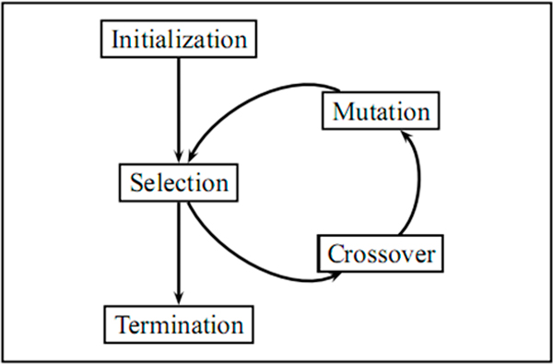
Genetic Algorithms
Nomenclature:
Chromosomes
Genes
Fitness
Make
random changes
Generate starting population
Select most fit to continue
Combine genes from parents to create new chromosomes
End after a condition is met

Slide 3
Genetic Algorithm: Finding Function Maximum
Gene: a single bit
Chromosomes: a string of 8 bits representing a number between 0 and 255
Fitness: the value of the function at x: sin(xπ/256)
Selection: randomly generate 8 values between 0 and 1 and select their corresponding chromosomes
Crossover: randomly select two parents and let the child chromosome consist of random genes from each parent
Mutation: decide at random whether to flip each individual bit in the chromosome

Slide 4
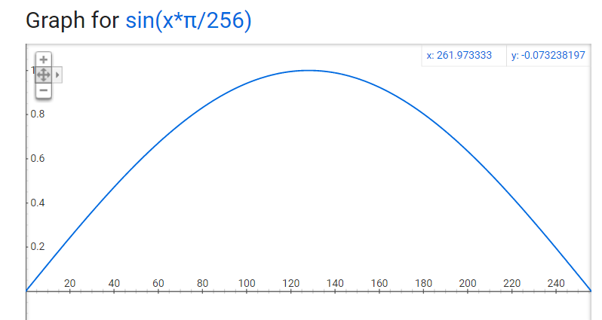

Slide 5
Genetic Algorithm: Traveling Salesperson Problem
Using Ordered Crossover
Gene: a vertex from the graph
Chromosome: a string of length n representing all vertices 1 through n once
Fitness: the length of the tour
Crossover: Order Crossover
Mutation: interchange two vertices or reverse order of a subset of vertices

Slide 6
Order Crossover
P₁ = 2 1 3 9 5 4 8 7 6
P₂ = 5 3 2 6 8 9 7 1 4
C₁ = 9 5 4
C₂ = 6 8 9
6
8
7
1
3
2
5 4 7 2 1 3

Slide 7
Genetic Algorithm: Traveling Salesperson Problem
Using Nearest Neighbor Crossover
Gene: a vertex from the graph
Chromosome: a string of length n representing all vertices 1 through n once
Fitness: the length of the tour
Crossover: Nearest Neighbor Crossover
Selection: top 50%
Mutation: select two vertices at random and reverse the subpath connecting them

Slide 8
Nearest Neighbor Crossover
Create a union graph using both parents’ edges.
Perform the Nearest Neighbor Algorithm.
Choose a random starting vertex to begin the tour.
Add an unvisited vertex that is closest to current last vertex in tour to the tour.

